Slide 1
AMSER Case of the Month HPI
Med sudent name and institution
Attending radiologist (must be AMSER member)
and institution
Your institution logo here

Slide 2
Patient Presentation

Slide 3
Pertinent Labs
If any

Slide 4
What Imaging Should We Order?

Slide 5
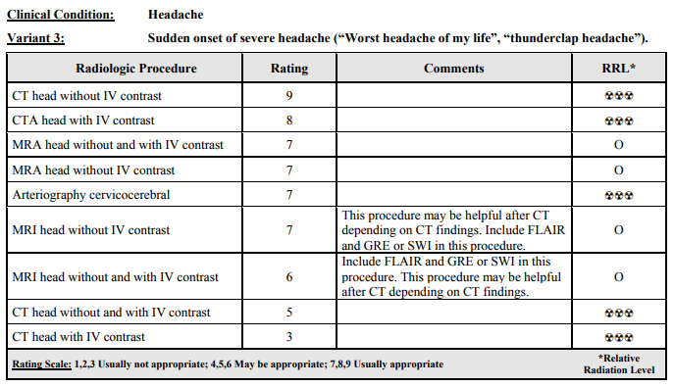
Select the applicable ACR Appropriateness Criteria
This imaging modality was ordered by the ER physician

Slide 6
Findings (unlabeled)

Slide 7
Findings: (labeled)

Slide 8
Final Dx: Spontaneous Hypertensive Intracranial Hemorrhage

Slide 9
Case Discussion (1-3 slides)

Slide 10
References:
Please include journal articles with references in AMA format and cite your discussions and figures appropriately. Minimum of 4 references are required.
Please remember to cite your references in your discussions and figures appropriately. Cases will be returned without proper citations.

